Slide 1
Control of Curvature Extrema in Curve Modeling
Ph.D. Dissertation
Zhipei Yan
6/10/2021

Slide 2
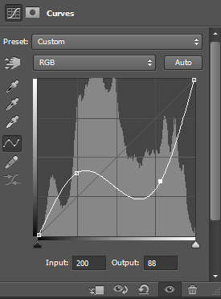
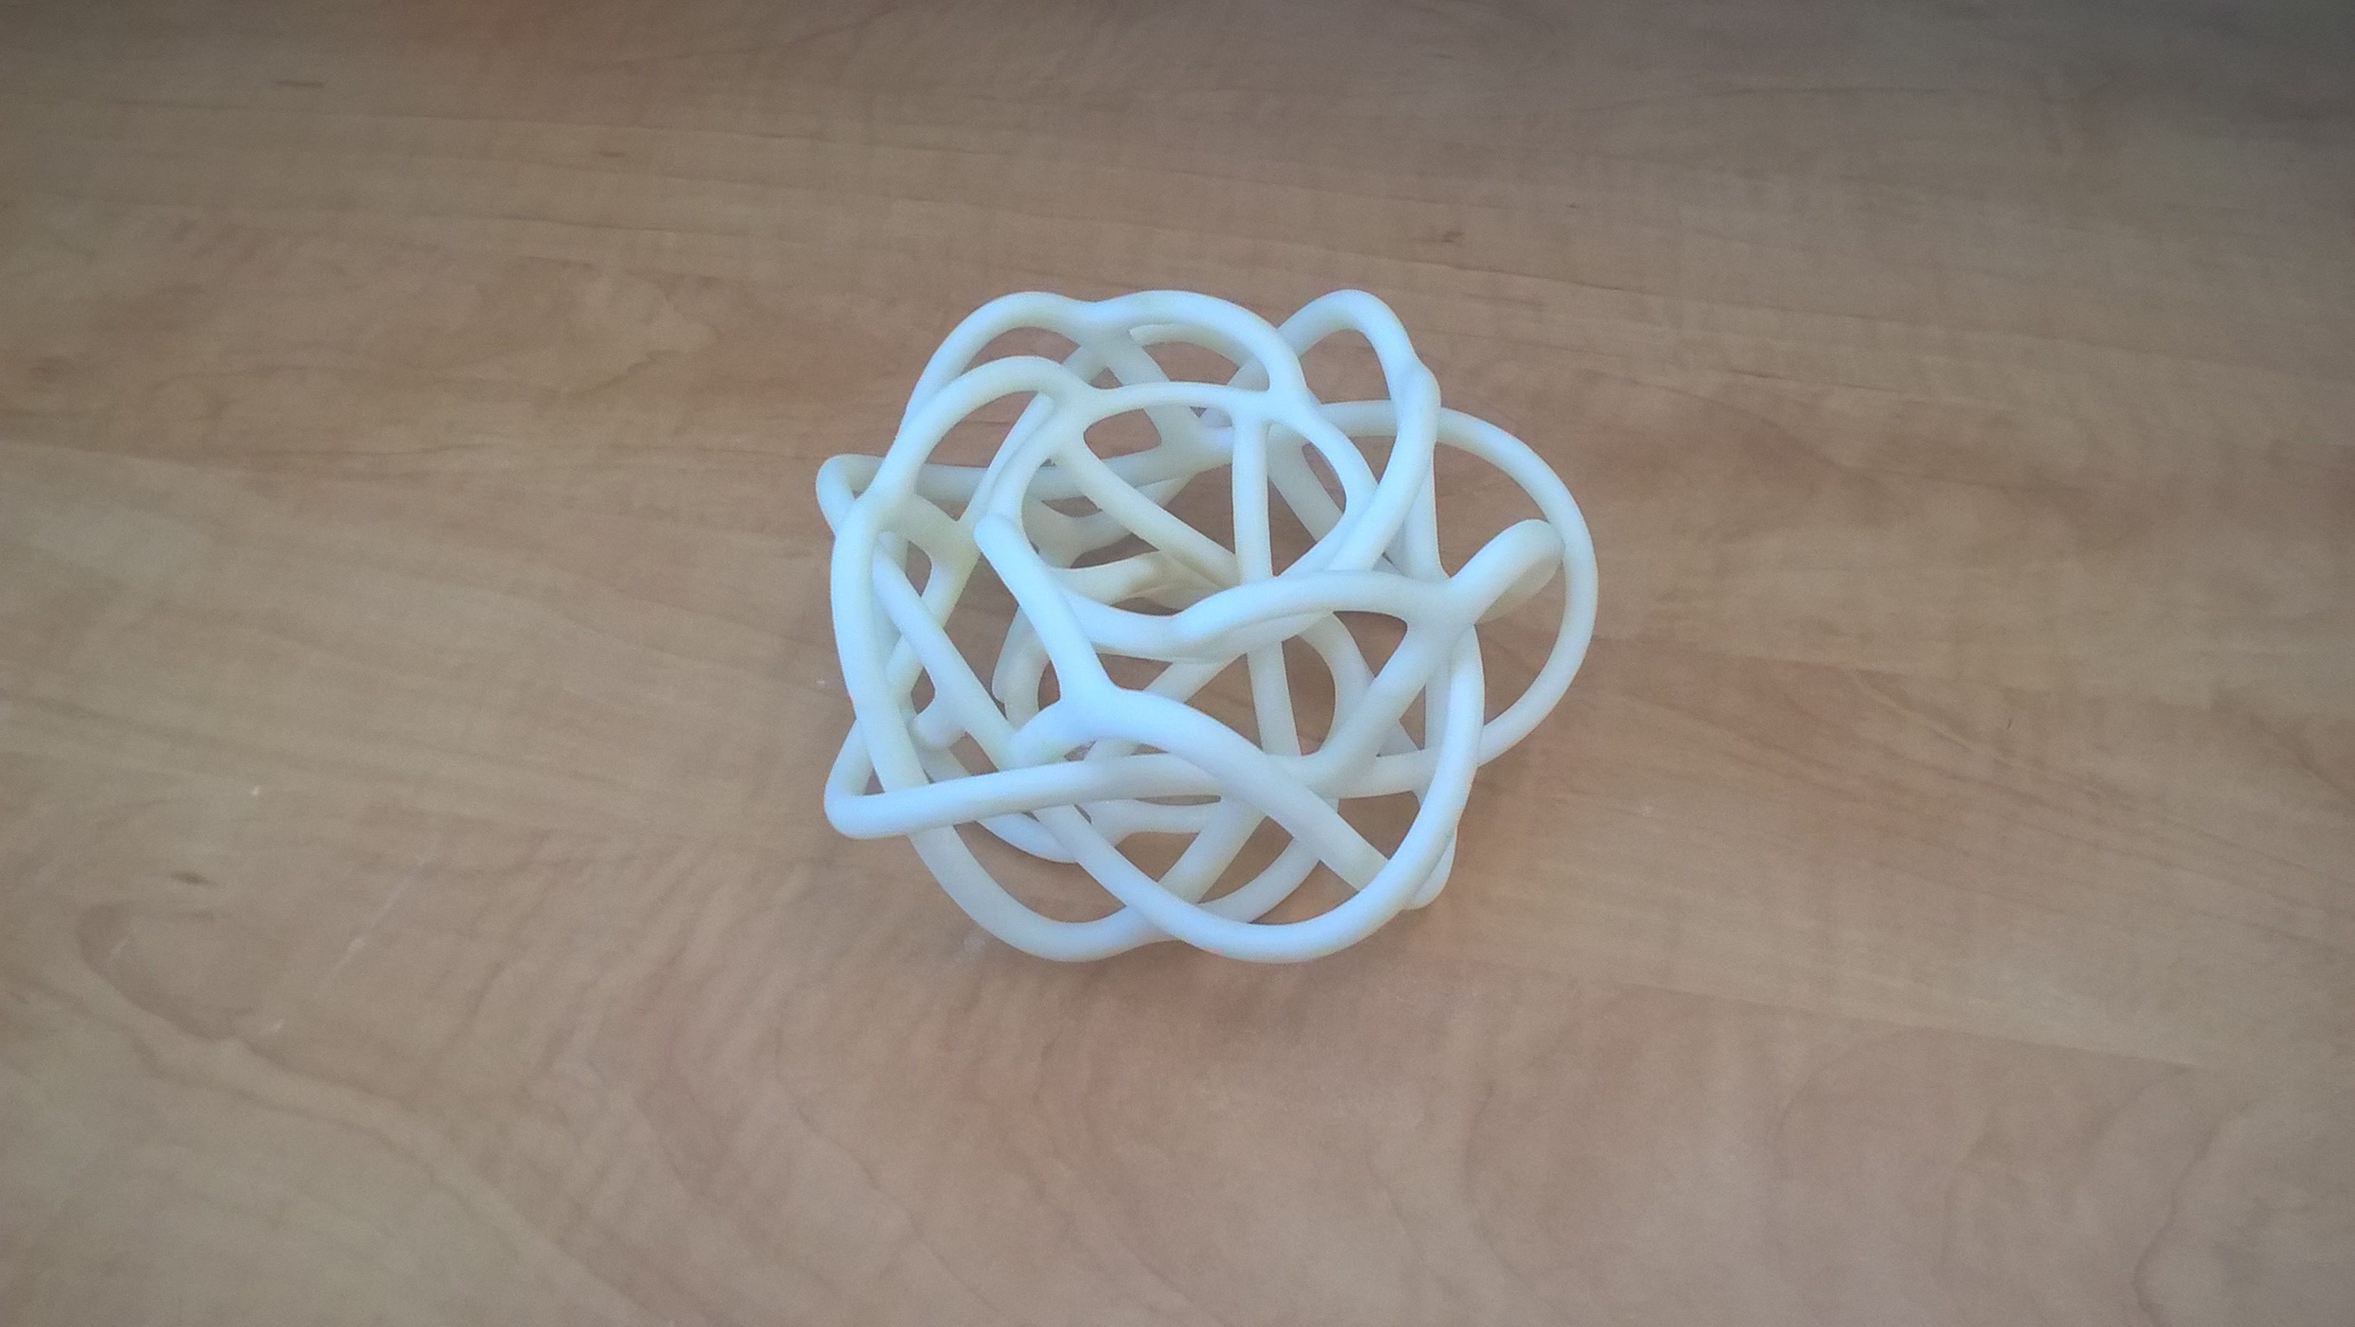
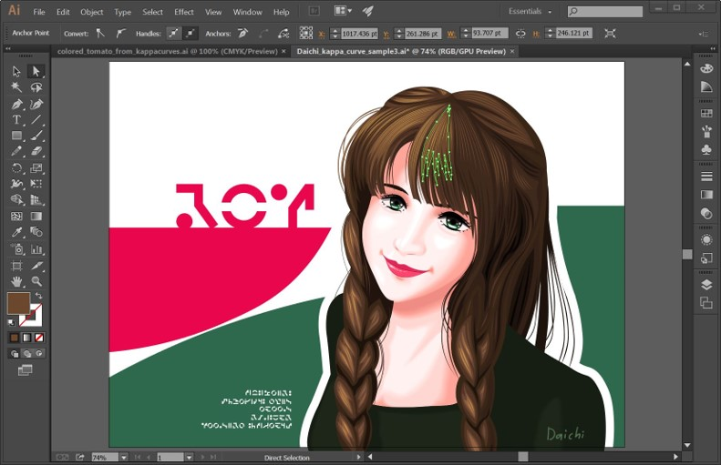
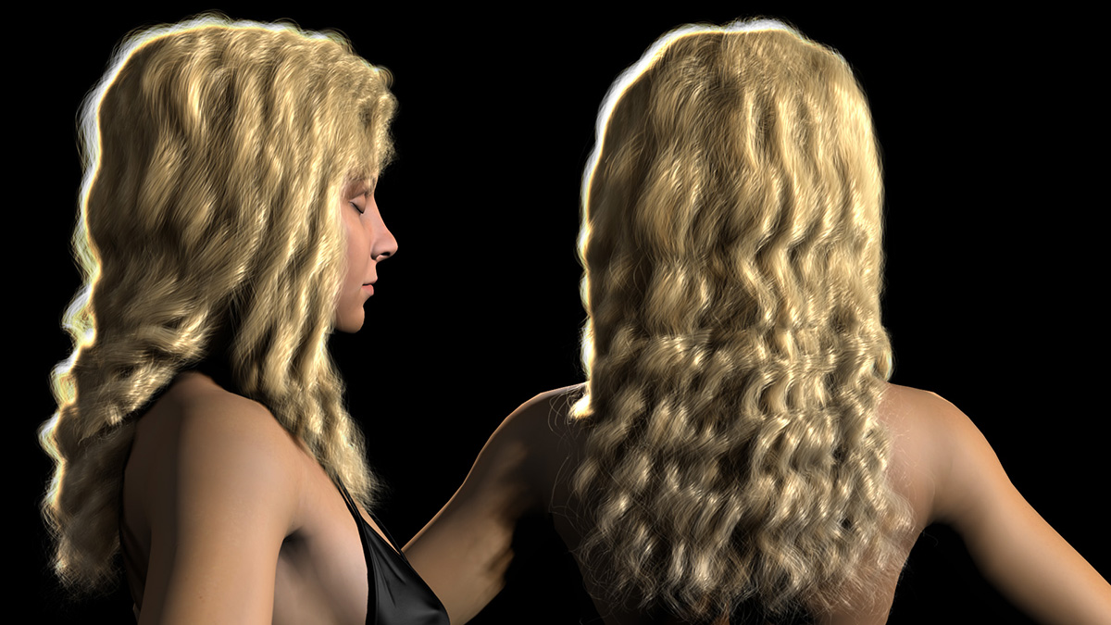
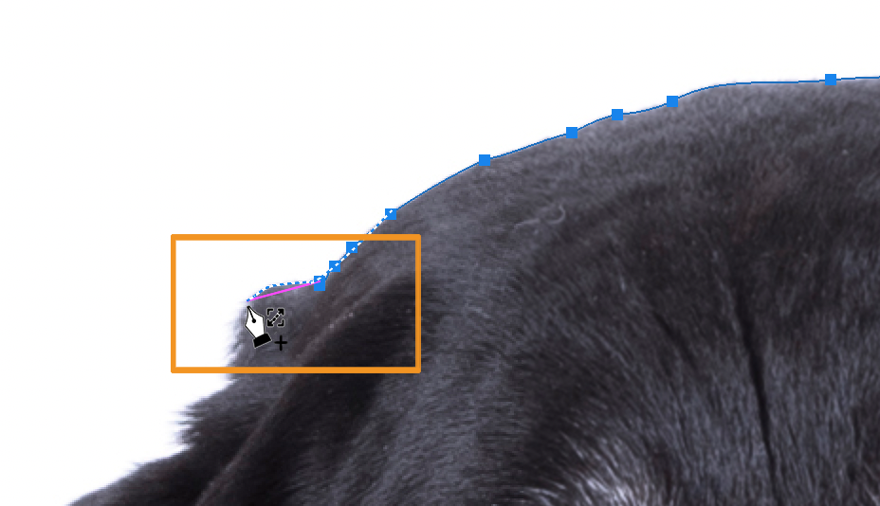
Curve Modeling
Shape drawing.
Image editing
Hair modeling.
Video effects using spline blending.
Date interpolating.
… …
http://www.cemyuksel.com/research/interpolating_splines/
By Daichi Ito from Adobe Research
https://helpx.adobe.com/photoshop/using/drawing-pen-tools.html
Notes:
Picture sources:
Bottom left: http://www.cemyuksel.com/research/interpolating_splines/
Bottom middle: by Daichi Ito from Adobe Research
Bottom right: https://helpx.adobe.com/photoshop/using/drawing-pen-tools.html

Slide 3
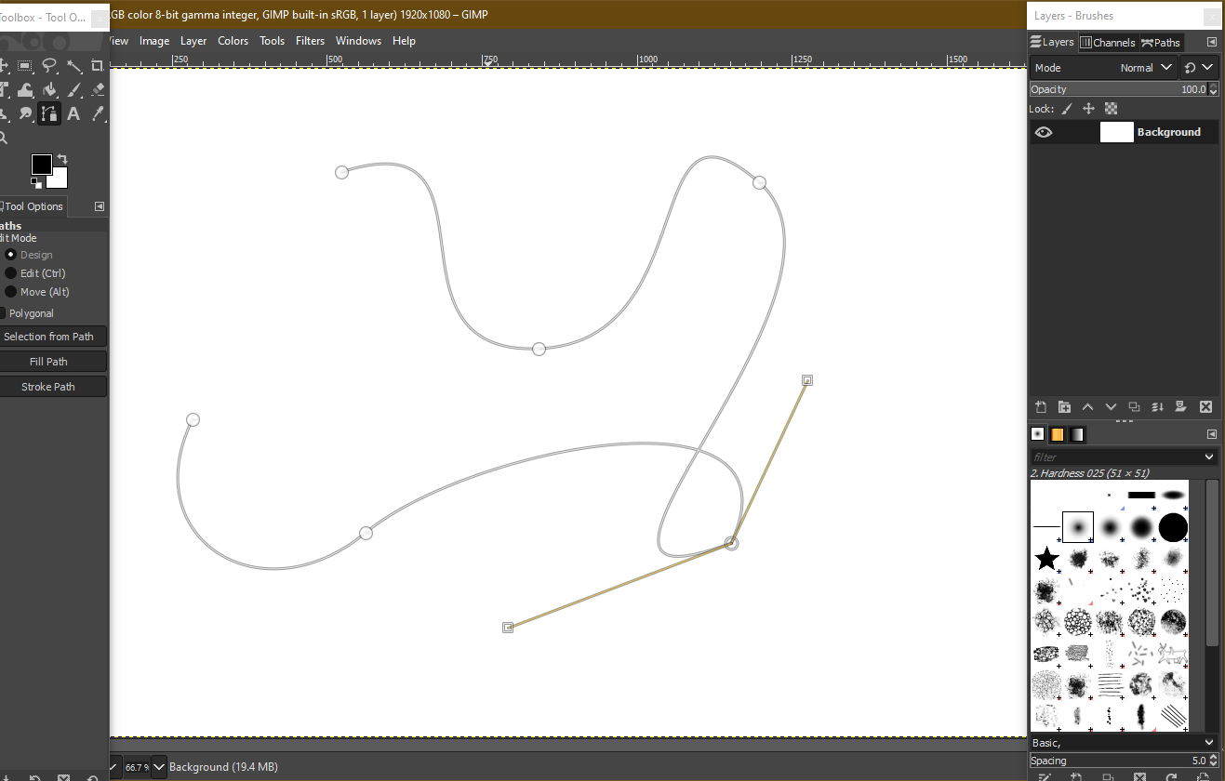
Motivation
Classic Pen Tool in Photoshop, Illustrator, GIMP, etc.
Where to put the handles?
Which short cut key to hold?
Require skills.

Slide 4
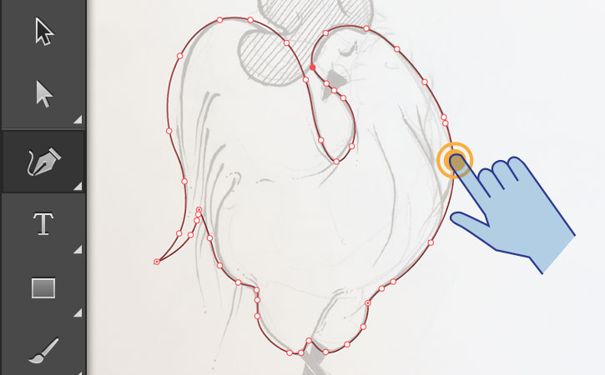
Motivation
We want:
Easy for beginners.
Drag the curve directly.
What you see is what you get.
Picture from https://helpx.adobe.com/illustrator/how-to/draw-touch-environment.html

Slide 5
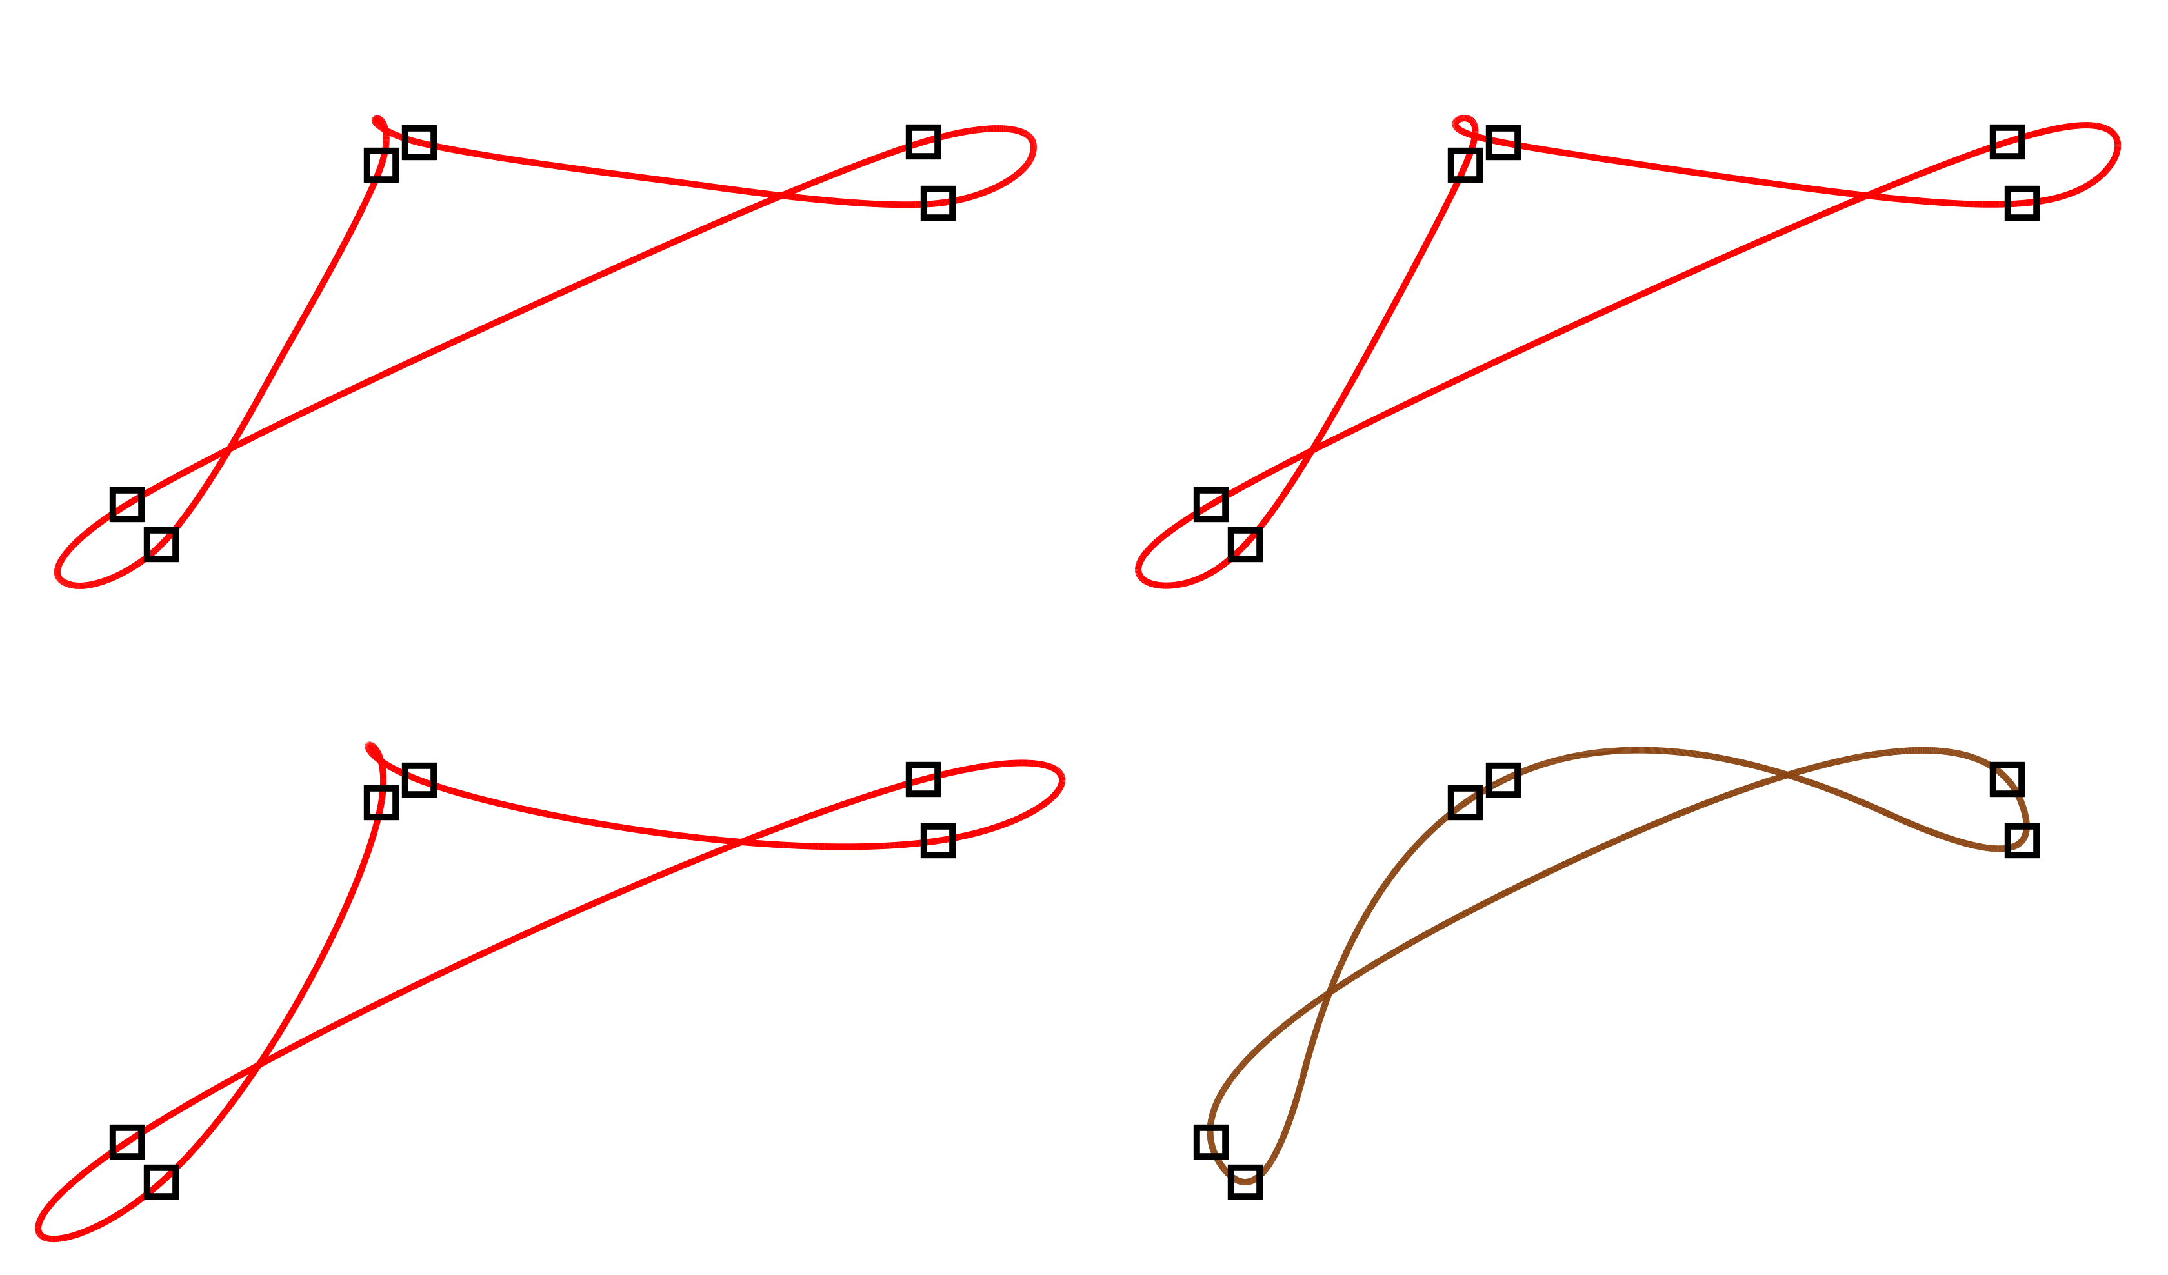
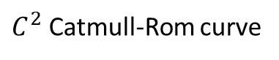
Motivation
$C^{2}$ Catmull-Rom curve
Interpolatory B-Spline

Slide 6
Salient features
[Levien 2009]

Slide 7
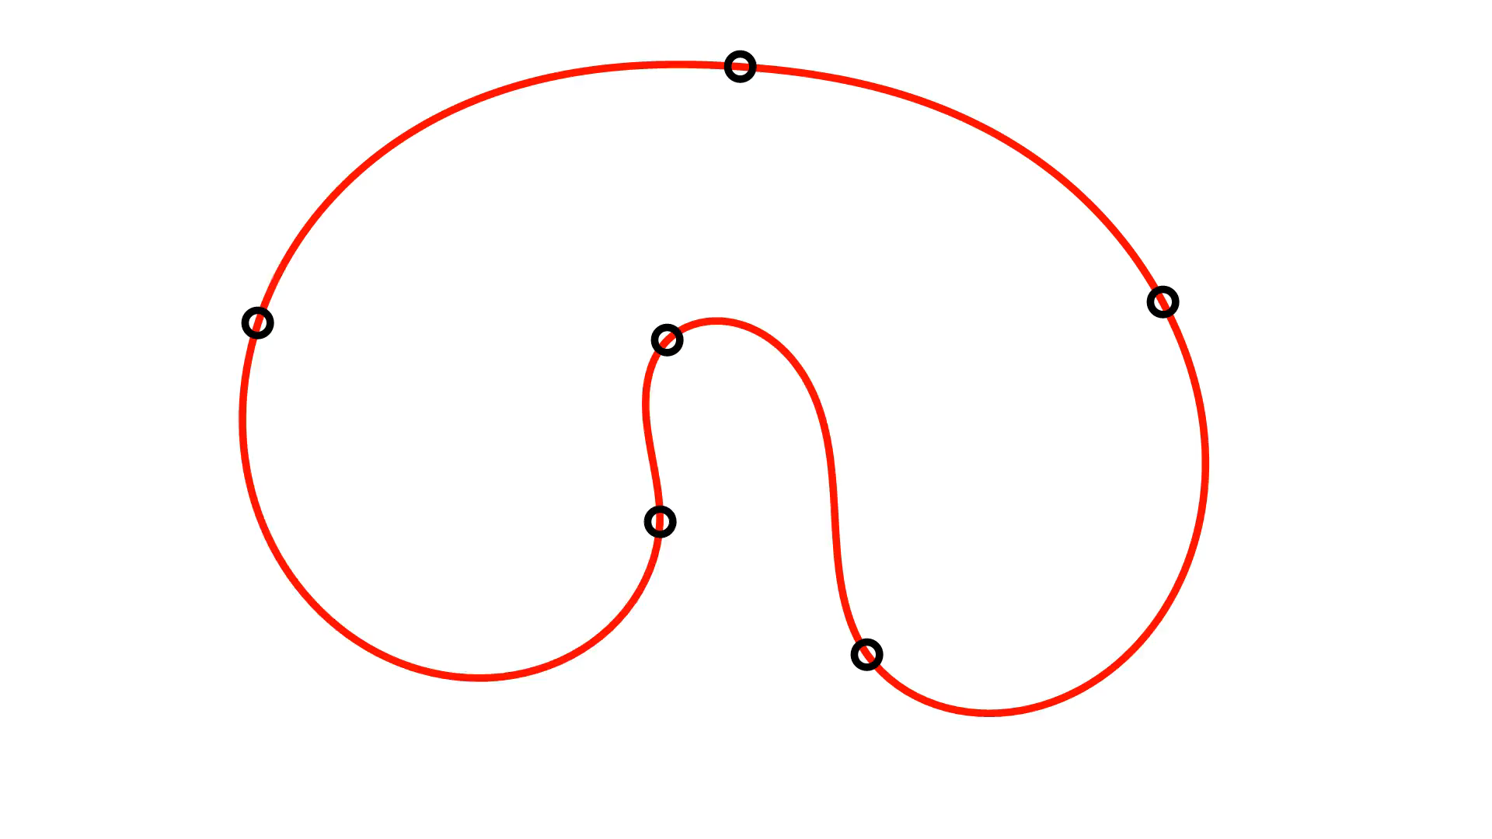
Locality
Clothoid/Euler Spiral
Curvature is linearly distributed

Slide 8
Fairness
Usually, we want the curvature distribution to be simple.

Slide 9
Geometric Requirements
The curve must interpolate all the control points.
“Salient” points must appear at the input points.
When the user is dragging the control points, the curve must move continuously.
The curve should be as “fair” as possible.

Slide 10
Math Background

Slide 11
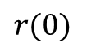
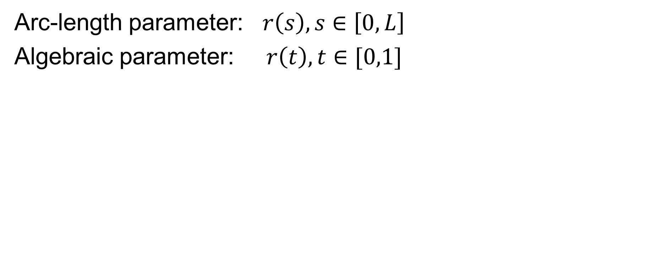
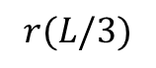
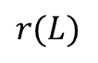
Curve
Arc-length parameter: $r\left(s\right), s∈\left[0, L\right]$
Algebraic parameter: $r\left(t\right), t∈[0,1]$
$$r(L/3)$$
$$r(L)$$
$$r(0)$$

Slide 12
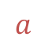
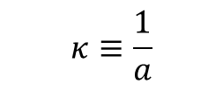
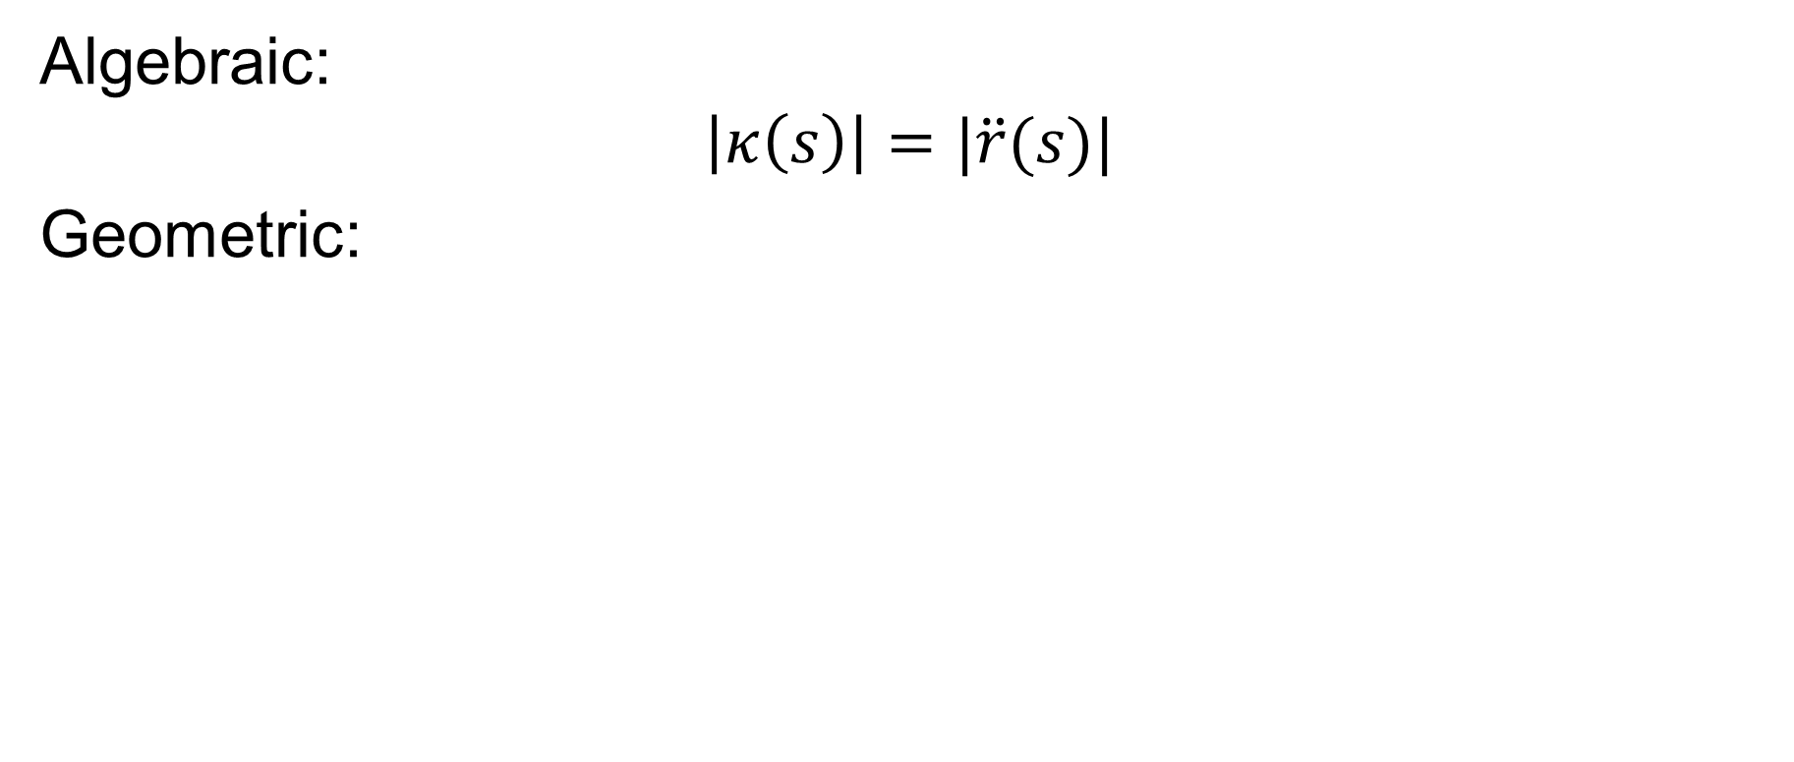
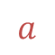

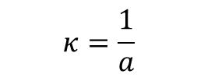
Curvature
Algebraic:
$$\left|κ\left(s\right)\right|=|\ddot{r}(s)|$$
Geometric:
$$a$$
$$a$$
$$κ=\frac{1}{a}$$
$$κ≡\frac{1}{a}$$
$$κ=0$$

Slide 13
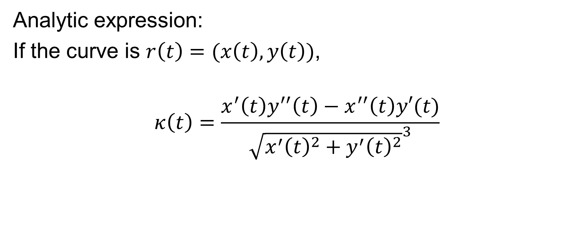
Curvature
Analytic expression:
If the curve is $r\left(t\right)=(x\left(t\right),y\left(t\right))$,
$$κ\left(t\right)=\frac{x^{′}\left(t\right)y^{′′}\left(t\right)−x^{′′}\left(t\right)y′(t)}{{\sqrt{x^{′}{\left(t\right)}^{2}+y^{′}{\left(t\right)}^{2}}}^{3}}$$

Slide 14
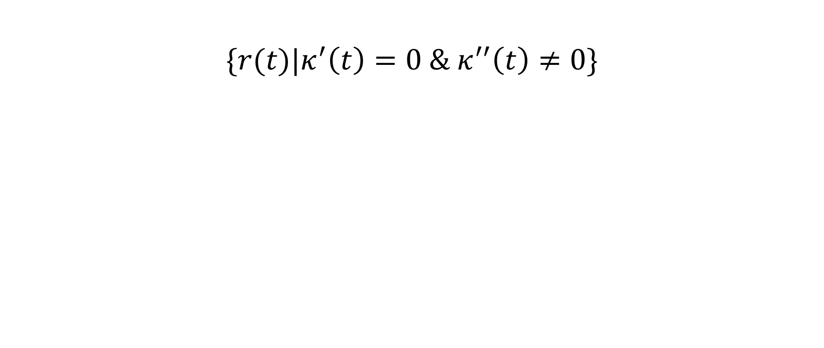
Curvature Critical Point
$$\{r(t)|κ^{′}\left(t\right)=0 \& κ^{′′}\left(t\right)≠0\}$$
“Salient” points.

Slide 15
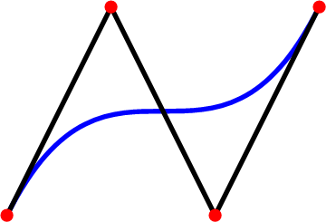
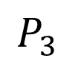
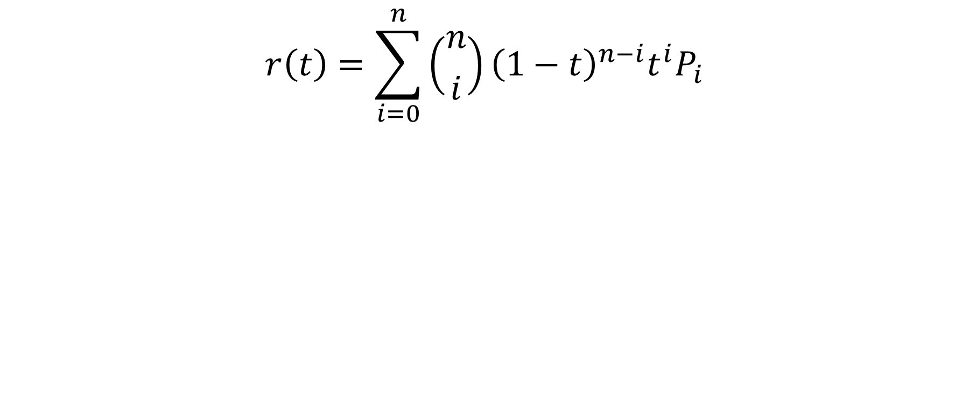
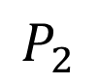
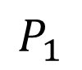
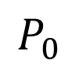
Bézier Curves
$$r\left(t\right)=\sum_{i=0}^{n}{\left({n \atop i}\right){\left(1−t\right)}^{n−i}t^{i}P_{i}}$$
$$P_{1}$$
$$P_{3}$$
$$P_{0}$$
$$P_{2}$$

Slide 16
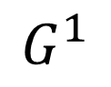
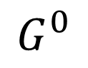
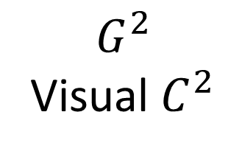
Geometric Continuity
Not continuous
$$G^{0}$$
$$G^{1}$$
$$G^{2}$$
Visual $C^{2}$

Slide 17
Methodology

Slide 18
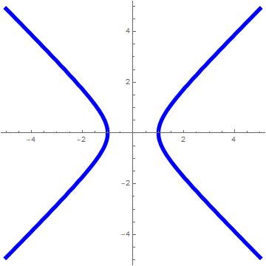
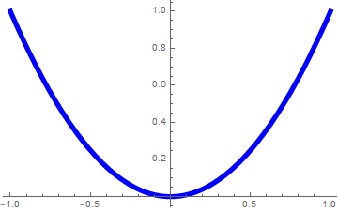
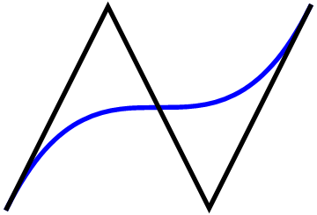
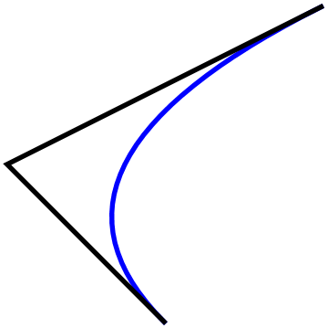
Curve Primitives

Slide 19
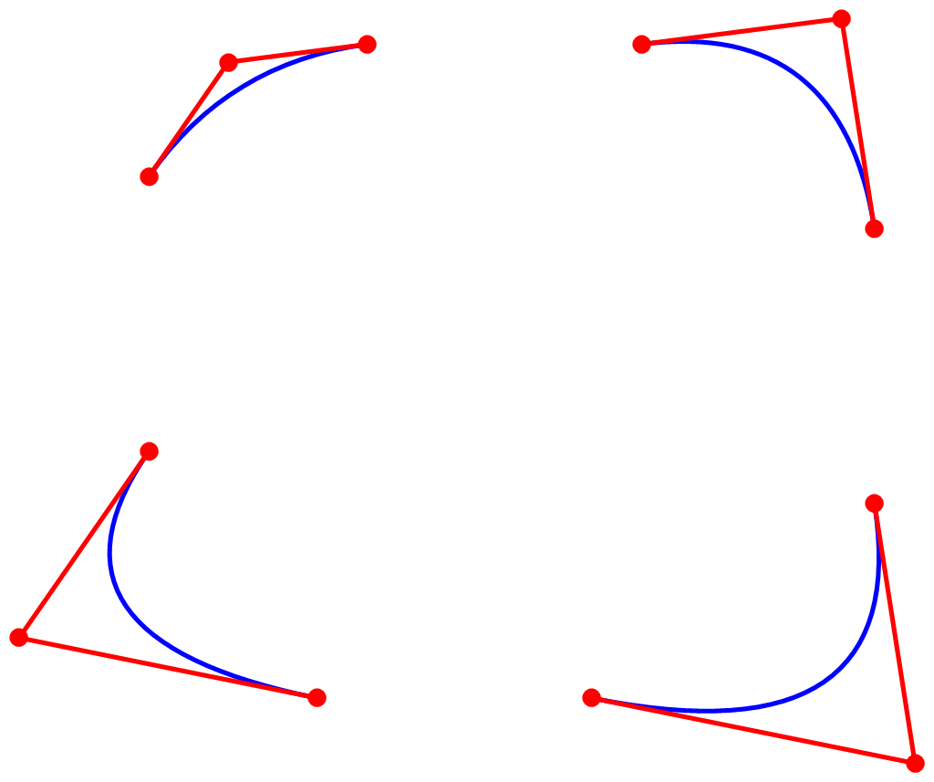
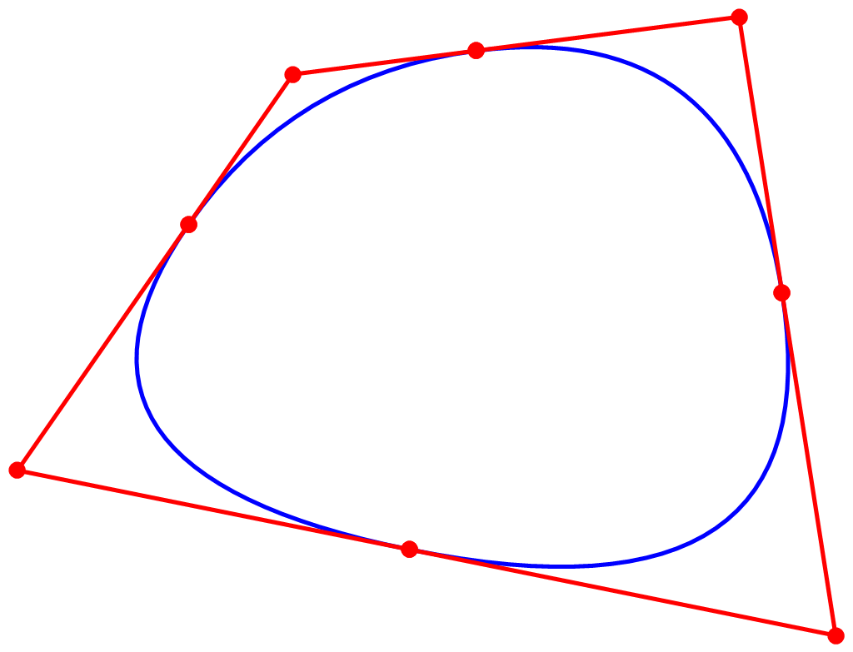
Connections

Slide 20
Constraints
Each local curve segment should interpolate the input point as “salient” points.
Each two adjacent curve segment should be connected in some “smooth” way.

Slide 21
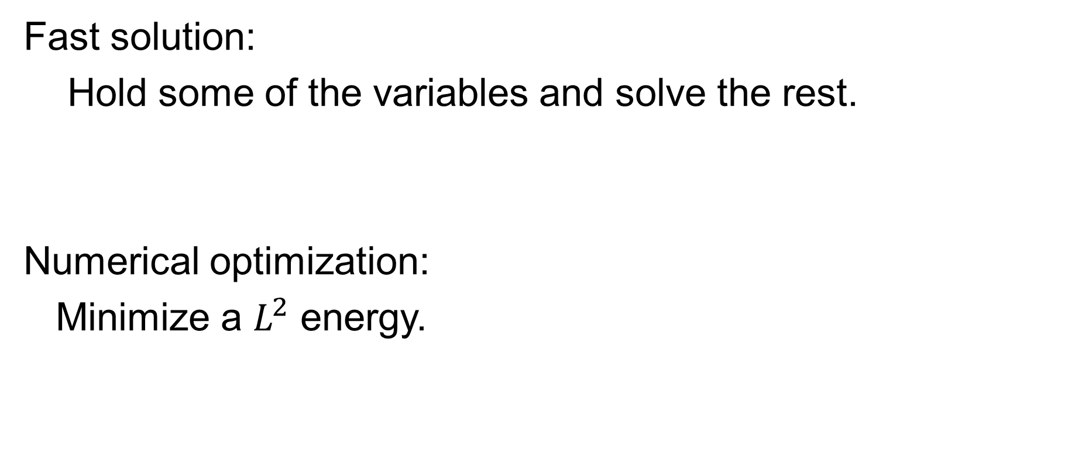
Optimization
Fast solution:
Hold some of the variables and solve the rest.
Numerical optimization:
Minimize a $L^{2}$ energy.

Slide 22

Polynomial Quadratic Curves
$κ$-Curves

Slide 23
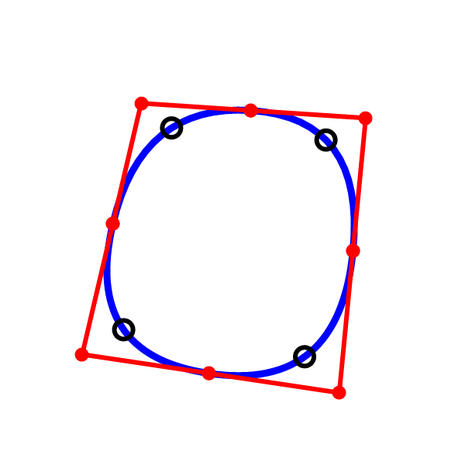
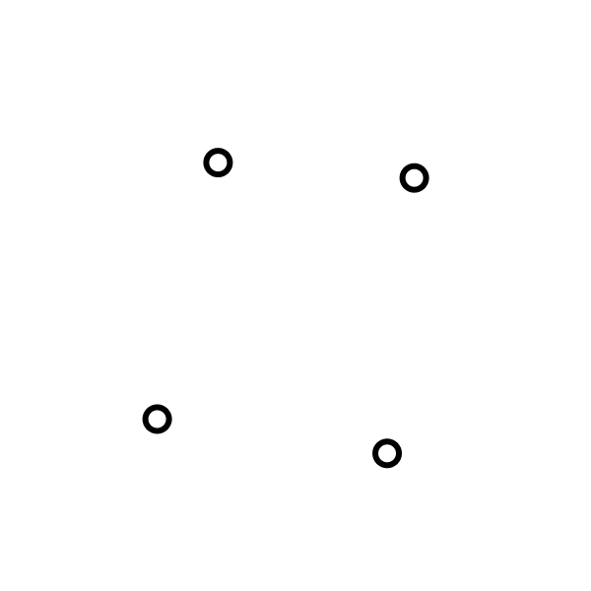
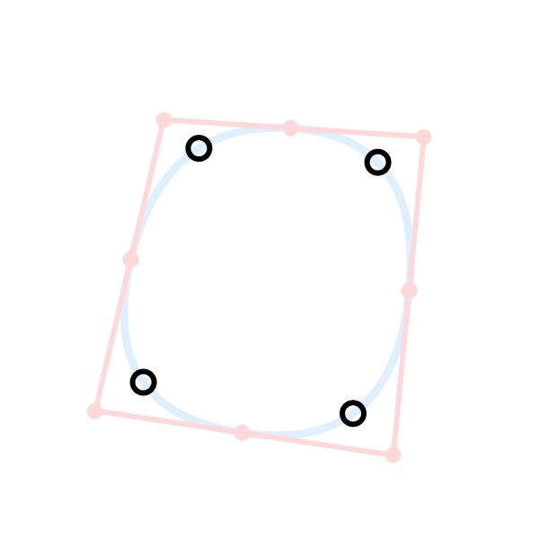
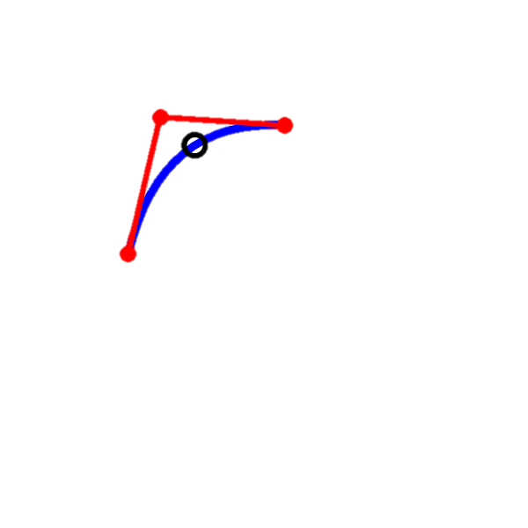
Basic Idea
Compute parabola for each point.
Connect all the segments together.
Adjust the locations of the curves, to satisfy the geometric constraints.

Slide 24
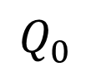
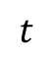
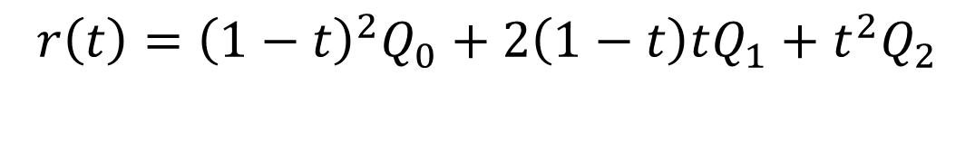
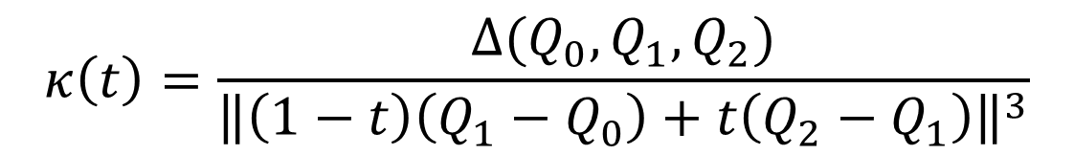
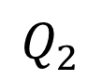
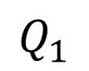
Polynomial Quadratic
$$r\left(t\right)={{\left(1−t\right)}^{2}Q}_{0}+2\left(1−t\right)tQ_{1}+t^{2}Q_{2}$$
$$Q_{1}$$
$$κ\left(t\right)=\frac{Δ(Q_{0},Q_{1},Q_{2})}{{\left\|\left(1−t\right)\left(Q_{1}−Q_{0}\right)+t\left(Q_{2}−Q_{1}\right)\right\|}^{3}}$$
$$t$$
$$Q_{0}$$
$$Q_{2}$$

Slide 25
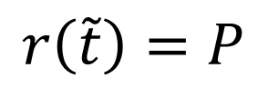
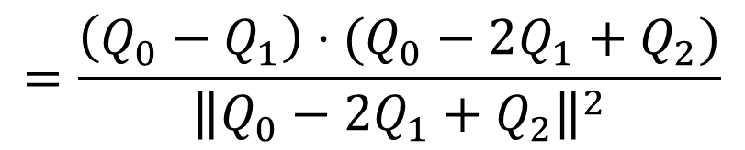
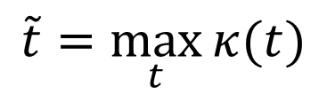

Polynomial Quadratic
$$=\frac{\left(Q_{0}−Q_{1}\right)⋅(Q_{0}−2Q_{1}+Q_{2})}{{\left\|Q_{0}−2Q_{1}+Q_{2}\right\|}^{2}}$$
$$\tilde{t}=\max_{t}{κ(t)}$$
$$Q_{1}$$
Salient point
$$P$$
$$r\left(\tilde{t}\right)=P$$
$$t$$
Input point
$$Q_{0}$$
$$Q_{2}$$

Slide 26



Local Solution
$$\left\{\begin{matrix}P={{\left(1−\tilde{t}\right)}^{2}Q}_{0}+2\left(1−\tilde{t}\right)\tilde{t}Q_{1}+{\tilde{t}}^{2}Q_{2} \\ \tilde{t}=\frac{\left(Q_{0}−Q_{1}\right)⋅(Q_{0}−2Q_{1}+Q_{2})}{{\left\|Q_{0}−2Q_{1}+Q_{2}\right\|}^{2}}\end{matrix}\right.$$
$$A{\tilde{t}}^{3}+B{\tilde{t}}^{2}+C\tilde{t}+D=0$$
Coefficients A, B, C, D are only about $Q_{0},Q_{2}$ and $P$
We proved there’s a unique $\tilde{t}∈(0,1)$

Slide 27


Local Solution
Geometric Meaning:

Slide 28

Local Solution

Slide 29



Curve Connection
$$G^{1}$$
$$G^{0}$$
Degree of constraints: 2
Degree of constraints: 3
$G^{2}$ requires one more degree of constraint.

Slide 30



Curve Connection
$$G^{1}$$
D
$$κ_{L}$$
$$κ_{R}$$
B
C
A
C=(1-λ)B+λD
E

Slide 31



Curve Connection
$$κ_{L}$$
$$κ_{R}$$

Slide 32


$G^{2}$ Joint
D
$$C=\left(1−λ\right)B+λD$$
$$λ=\frac{\sqrt{Δ\left(A,B,D\right)}}{\sqrt{Δ\left(A,B,D\right)}+\sqrt{Δ\left(B,D,E\right)}}∈(0,1)$$
C
B
A
E

Slide 33

$G^{2}$ Joint
Inflection case.
$$λ=\frac{\sqrt{|Δ\left(A,B,D\right)|}}{\sqrt{|Δ\left(A,B,D\right)|}+\sqrt{|Δ\left(B,D,E\right)|}}∈(0,1)$$
E
C
B
D
A

Slide 34











Algebraic Representation
Given input points: $P_{1},P_{2},⋯,P_{n}$
Compute the control polygon:
${\{Q}_{i}\}, \left\{λ_{i}\right\}$
$$Q_{2}$$
$$λ_{2}$$
$$P_{2}$$
$$⋯$$
$$λ_{1}$$
$$P_{1}$$
$$P_{n}$$
$$Q_{1}$$
$$λ_{n}$$
$$Q_{n}$$

Slide 35

Algebraic Representation
Constraints:
$λ_{i}$ satisfies $G^{2}$
Each segment interpolate one input point $P_{i}$
Interpolate $P_{i}$ at the maximum curvature point
$$Q_{2}$$
$$λ_{2}$$
$$P_{2}$$
$$⋯$$
$$λ_{1}$$
$$P_{1}$$
$$P_{n}$$
$$Q_{1}$$
$$λ_{n}$$
$$Q_{n}$$

Slide 36


Algebraic Representation
Interpolation:
$$\left\{\begin{matrix}\begin{aligned}⋮ \\ \end{aligned} \\ \begin{aligned}{\left(1−t_{2}\right)}^{2}(\left(1−λ_{1}\right)Q_{1}+λ_{1}Q_{2}) \\ +2\left(1−t_{2}\right)t_{2}Q_{2} \\ +t_{2}^{2}\left(\left(1−λ_{2}\right)Q_{2}+λ_{2}Q_{3}\right)=P_{2} \\ \end{aligned} \\ ⋮\end{matrix}\right.$$
$n$ equations in $ℝ^{2}$.
In total $2n$ equations.
$$Q_{2}$$
$$λ_{2}$$
$$P_{2}$$
$$⋯$$
$$λ_{1}$$
$$P_{1}$$
$$P_{n}$$
$$Q_{1}$$
$$λ_{n}$$
$$Q_{n}$$

Slide 37


Algebraic Representation
Curvature Maxima:
$$\left\{\begin{matrix}\begin{aligned}⋮ \\ \end{aligned} \\ A_{2}t_{2}^{3}+B_{2}t_{2}^{2}+C_{2}t_{2}+D_{2}=0 \\ \begin{aligned} \\ ⋮\end{aligned}\end{matrix}\right.$$
$n$ equations.
$$Q_{2}$$
$$t_{2}$$
$$λ_{2}$$
$$P_{2}$$
$$⋯$$
$$λ_{1}$$
$$P_{1}$$
$$P_{n}$$
$$Q_{1}$$
$$λ_{n}$$
$$Q_{n}$$

Slide 38


Algebraic Representation
$G^{2}$ connection:
$$\left\{\begin{matrix}\begin{aligned}⋮ \\ \end{aligned} \\ \frac{|Δ_{Q_{n}Q_{1}Q_{2}}|(1−λ_{n})}{λ_{1}^{2}}=\frac{\left|Δ_{Q_{1}Q_{2}Q_{3}}\right|λ_{2}}{{\left(1−λ_{1}\right)}^{2}} \\ \begin{aligned} \\ ⋮\end{aligned}\end{matrix}\right.$$
$n$ equations.
$$Q_{2}$$
$$λ_{2}$$
$$P_{2}$$
$$⋯$$
$$λ_{1}$$
$$P_{1}$$
$$P_{n}$$
$$Q_{1}$$
$$λ_{n}$$
$$Q_{n}$$

Slide 39


Algebraic Representation
$4n$ cubic equations with variables
$${\{t_{i},λ_{i},Q}_{i}\}$$
In total $4n$ variables.
$t_{i}$ is an intermediate variables.
$$Q_{2}$$
$$λ_{2}$$
$$P_{2}$$
$$⋯$$
$$λ_{1}$$
$$P_{1}$$
$$P_{n}$$
$$Q_{1}$$
$$λ_{n}$$
$$Q_{n}$$

Slide 40
Fast Solution
The 4n equation system is complex.
However, each variable has a closed form solution if we treat the rest variables as constants.

Slide 41


Fast Solution
Hold ${\{λ}_{i}\}$ and $\{Q_{i}\}$, solve all $t_{i}$ separately by
$$A_{i}t_{i}^{3}+B_{i}t_{i}^{2}+C_{i}t_{i}+D_{i}=0$$
Hold $\left\{t_{i}\right\}$ and $\{Q_{i}\}$, for each $i$, hold $λ_{i−1}$ and $λ_{i+1}$ to solve
$$λ_{i}=\frac{\sqrt{|Δ(Q_{i−1}Q_{i}Q_{i+1})|(1−λ_{i−1})}}{\sqrt{|Δ(Q_{i−1}Q_{i}Q_{i+1})|(1−λ_{i−1})}+\sqrt{|Δ(Q_{i}Q_{i+1}Q_{i+2})|λ_{i+1}}}$$
Hold $\{t_{i}\}$ and $\{λ_{i}\}$ and solve for $\{Q_{i}\}$
$$\left[\begin{matrix}a_{11} & a_{12} & a_{n1} \\ a_{2a} & a_{22} & ⋮ \\ \begin{aligned}⋱ \\ a_{n1}\end{aligned} & \begin{aligned}⋱ \\ ⋯\end{aligned} & \begin{aligned}⋮ \\ a_{nn}\end{aligned}\end{matrix}\right]⋅\left[\begin{matrix}Q_{1} \\ Q_{2} \\ \begin{aligned}⋮ \\ Q_{n}\end{aligned}\end{matrix}\right]=\left[\begin{matrix}P_{1} \\ P_{2} \\ \begin{aligned}⋮ \\ P_{n}\end{aligned}\end{matrix}\right]$$
Cyclic tri-diagonal

Slide 42
Iterations 0 to 10

Slide 43
Properties
Curvature maxima only occur at input points.
Curvature continuous unless inflection points.
Quasi-locality.
Real-time solution.

Slide 44


Slide 45



Inflection Point

Slide 46



Relationship to Parabolas

Slide 47

Relationship to Parabolas
Input points
Curvature maxima

Slide 48

Cusps

Slide 49

Quasi Locality

Slide 50

Examples

Slide 51

Examples

Slide 52

Limitations of $κ$-Curves
Only parabolas.
Conic sections.
Cubic curves
No extra degree-of-freedom
Shape parameters
Higher degrees
Extensions:
Rational Quadratic
Cubic

Slide 53
Rational Quadratic Curves

Slide 54
Goal
More shape control.
Circle reproduction.

Slide 55

Construction
The whole framework is similar to $κ$-Curves.

Slide 56







Rational quadratic curves
$$r\left(t\right)=\frac{{\left(1−t\right)}^{2}Q_{0}+2\left(1−t\right)twQ_{1}+t^{2}Q_{2}}{{\left(1−t\right)}^{2}+2\left(1−t\right)tw+t^{2}}$$
$$w>1$$
$w=$1
$0<w<$1
Hyperbola
Parabola
Ellipse

Slide 57

Single Segment
$κ\left(t\right)=\frac{r^{′′}\left(t\right)⋅r^{′}{\left(t\right)}^{⊥}}{|r′(t)|^3}$ and $κ^{′}\left(t\right)=0$ yields
$${\left[\begin{matrix}{\left(1−t\right)}^{4} \\ 4{\left(1−t\right)}^{3}t \\ \begin{aligned}6{\left(1−t\right)}^{2}t^{2} \\ 4\left(1−t\right)t^{3} \\ t^{4}\end{aligned}\end{matrix}\right]}^{T}⋅\left[\begin{matrix}−2w^{3}{\left|Q_{0}−Q_{1}\right|}^{2}+w\left(Q_{0}−Q_{1}\right)⋅\left(Q_{0}−Q_{2}\right) \\ −w^{2}{\left|Q_{0}−Q_{1}\right|}^{2}+1/4{\left|Q_{0}−Q_{2}\right|}^{2} \\ \begin{aligned}1/2w\left(Q_{2}−Q_{0}\right)⋅\left(Q_{0}−2Q_{1}+Q_{2}\right) \\ −1/4{\left|Q_{0}−Q_{2}\right|}^{2}+w^{2}{\left|Q_{1}−Q_{2}\right|}^{2} \\ −w\left(Q_{0}−Q_{2}\right)⋅\left(Q_{1}−Q_{2}\right)+2w^{3}{\left|Q_{1}−Q_{2}\right|}^{2}\end{aligned}\end{matrix}\right]=0$$

Slide 58






Single Segment Simplification
$$P=\frac{{\left(1−t\right)}^{2}Q_{0}+2\left(1−t\right)twQ_{1}+t^{2}Q_{2}}{{\left(1−t\right)}^{2}+2\left(1−t\right)tw+t^{2}}$$
$$Q_{1};w$$
$$P$$
reform
$$Q_{0}$$
$$Q_{2}$$
$$Q_{1}=\frac{\left({\left(1−t\right)}^{2}+2\left(1−t\right)tw+t^{2}\right)P−{\left(1−t\right)}^{2}Q_{0}−t^{2}Q_{2}}{2\left(1−t\right)tw}$$

Slide 59

Single Segment Simplification
$$−wA{\left(1−t\right)}^{4}−\left(A+B\right){\left(1−t\right)}^{3}t+\left(B+C\right)\left(1−t\right)t^{3}+wCt^{4}=0$$
where
$$A=\left(Q_{0}−P\right)⋅\left(Q_{0}−P\right)$$
$$B=\left(Q_{0}−P\right)⋅(Q_{2}−P)$$
$$C=\left(Q_{2}−P\right)⋅\left(Q_{2}−P\right)$$
We proved a unique root $\tilde{t}∈(0,1)$

Slide 60












Geometric Meaning
$$r\left(t\right)=r(t;Q_{0}{,Q}_{1},Q_{2},w)$$
Any given
$$w$$
$$Q_{1}$$
unique
$$P$$
$$P$$
$$Q_{0}$$
$$Q_{2}$$
$$Q_{0}$$
$$Q_{2}$$
$$P=r\left(\tilde{t}\right)$$
$$κ^{′}\left(\tilde{t}\right)=0$$

Slide 61






Weights
Fix black circles and change weight $w$ only.
$w=$0.5
$$w=1$$
$$w=2$$
Hyperbola
Parabola
Ellipse

Slide 62


Uniform weight
All weights are one.
This is $κ$-Curve.
Everything is fine.

Slide 63


Large weight
$w>1$, curves are hyperbolas,
One branch has only one curvature maxima,
the two sides are curvature monotonous.
Larger weights are always safe.

Slide 64


Large weight
When $w→+∞$, the curve goes to the control polygon.
So, our curve can estimate polygons
with sharp corners.

Slide 65


Small weight
$0<w<1$, the curve is part of an ellipse.
$κ^{′}\left(t\right)=0$ can be curvature minima.
Geometric criteria can’t be met.
Optimization is unstable.

Slide 66

Small weight

Slide 67

Minimum Eccentricity Weight
Some weigh function can avoid the curvature minima of an ellipse.
A good lower bound of the weights.
Reproduce circles when possible.

Slide 68


Minimum Eccentricity Weight
When $w<1$, the curve is always an ellipse.
Find some weight so that the eccentricity
of the ellipse is minimized.

Slide 69



Minimum Eccentricity Weight
Eccentricity defines how squashed an ellipse is.
$$e=\sqrt{1−\frac{b^{2}}{a^{2}}}∈[0,1)$$
Here $b≤a$,
and $e=0$ means a circle.
$$b$$
$$a$$

Slide 70

Minimum Eccentricity Weight
For general expression of an ellipse
$$Ax^{2}+Bxy+Cy^{2}+Dx+Ey+F=0$$
The eccentricity is
$$e=\sqrt{\frac{2\sqrt{{\left(A−C\right)}^{2}+B^{2}}}{A+C+\sqrt{{\left(A−C\right)}^{2}+B^{2}}}}$$

Slide 71

Minimum Eccentricity Weight
Write $r\left(t\right)=\frac{{\left(1−t\right)}^{2}Q_{0}+2\left(1−t\right)twQ_{1}+t^{2}Q_{2}}{{\left(1−t\right)}^{2}+2\left(1−t\right)tw+t^{2}}$ in the general form.
Then $e$ is a function about $Q_{0},Q_{1},Q_{2}$ and $w$.
Treat $Q_{i}$ as constants and compute $\frac{∂e}{∂w}=0$, which result in
$$w=\sqrt{\frac{{\left|Q_{0}−Q_{2}\right|}^{2}}{2{(|Q_{0}−Q_{1}|}^{2}+{|Q_{2}−Q_{1}|}^{2})}}$$

Slide 72

Minimum Eccentricity Weight
$0<\sqrt{\frac{{\left|Q_{0}−Q_{2}\right|}^{2}}{2{(|Q_{0}−Q_{1}|}^{2}+{|Q_{2}−Q_{1}|}^{2})}}≤1$
The weight uses $Q_{1}$ rather than $P$,
so when $Q_{0},P,Q_{2}$ form a minor arc,
we can achieve $e=0$

Slide 73





Minimum Eccentricity Weight
Minimum Eccentricity Weight is not valid when $Q_{0}, P, Q_{2}$ are forming a major arc.
$$P$$
$$Q_{0}$$
$$Q_{2}$$

Slide 74






Minimum Eccentricity Weight
A circle requires at least three point.
$$w=\frac{1}{2}$$
$$w=\frac{\sqrt{2}}{2}≈0.707$$
$$w=\frac{1+\sqrt{5}}{4}≈0.809$$

Slide 75

Clamped Min Eccentricity Weight
Clamped Min Eccentricity Weight:
$$W=\max_{}\left(\frac{1}{2}, μ\sqrt{\frac{{\left|Q_{0}−Q_{2}\right|}^{2}}{2{(|Q_{0}−Q_{1}|}^{2}+{|Q_{2}−Q_{1}|}^{2})}}\right)$$
$μ$ is any user define positive value, 1 by default.

Slide 76



$G^{2}$ conditions
$$G^{1}$$
D,$w_{D}$
B,$w_{B}$
$$κ_{L}$$
$$κ_{R}$$
C
A
C=(1-λ)B+λD
E

Slide 77



$G^{2}$ conditions
D,$w_{D}$
B,$w_{B}$
C
$$C=\left(1−λ\right)B+λD$$
$$λ=\frac{\sqrt{\left|Δ\left(A,B,D\right)\right|}/w_{B}}{\sqrt{\left|Δ\left(A,B,D\right)\right|}/w_{B}+\sqrt{Δ\left(B,D,E\right)}/w_{D}}∈(0,1)$$
A
E

Slide 78




Problem Formulation
Given input points: $P_{1},P_{2},⋯,P_{n}$
Compute the control polygon:
${\{Q}_{i}\}, \{w_{i}\},\left\{λ_{i}\right\}$
$$Q_{2},w_{2}$$
$$λ_{2}$$
$$P_{2}$$
$$⋯$$
$$λ_{1}$$
$$P_{1}$$
$$P_{n}$$
$$Q_{1},w_{1}$$
$$λ_{n}$$
$$Q_{n},w_{n}$$

Slide 79

Problem Formulation
1. Interpolation:
$P_{i}=r\left(t_{i};Q_{i−1}Q_{i}Q_{i+1}λ_{i−1}λ_{i}w_{i}\right)$
2. Curvature Extrema:
$∗t_{i}^{4}+∗t_{i}^{3}+∗t_{i}^{2}+∗t_{i}+∗=0$
3. Weight function:
$w_{i}=MinEcc(Q_{i−1}Q_{i}Q_{i+1})$
4. $G^{2}$ joint:
$\frac{|ΔQ_{i−1}Q_{i}Q_{i+1}|(1−λ_{i−1})}{w_{i}^{2}λ_{i}^{2}}=\frac{\left|ΔQ_{i}Q_{i+1}Q_{i+2}\right|λ_{i+1}}{w_{i+1}^{2}{\left(1−λ_{i}\right)}^{2}}$
$$Q_{2},w_{2}$$
$$λ_{2}$$
$$P_{2}$$
$$⋯$$
$$λ_{1}$$
$$P_{1}$$
$$P_{n}$$
$$Q_{1},w_{1}$$
$$λ_{n}$$
$$Q_{n},w_{n}$$

Slide 80

Fast Solution
Compute the weight function $w_{i}$
Hold $\left\{w_{i}\right\}, {\{λ}_{i}\}$ and $\{Q_{i}\}$, solve all $t_{i}$ from the quartic polynomial
Hold $\left\{w_{i}\right\}, \left\{t_{i}\right\}$ and $\{Q_{i}\}$, for each $i$, hold $λ_{i−1}$ and $λ_{i+1}$ to solve $λ_{i}$
Hold $\left\{w_{i}\right\}, \{t_{i}\}$ and $\{λ_{i}\}$ and solve for $\{Q_{i}\}$ from a linear system.

Slide 81

Numerical Optimization
The fast solution can approach the solution rapidly,
but can’t always converge.
We built a $L^{2}$ norm optimization using the fast solution as the initial guess so that optimization can converge quickly.

Slide 82

Energy Definition
Curvature Extrema:
$$E_{C}=\sum_{i}{{\left(∗t_{i}^{4}+∗t_{i}^{3}+∗t_{i}^{2}+∗t_{i}+∗\right)}^{2}}$$
$G^{2}$ condition:
$$E_{G^{2}}=\sum_{i}{{\left(\frac{\left|ΔQ_{i−1}Q_{i}Q_{i+1}\right|\left(1−λ_{i−1}\right)}{w_{i}^{2}λ_{i}^{2}}−\frac{\left|ΔQ_{i}Q_{i+1}Q_{i+2}\right|λ_{i+1}}{w_{i+1}^{2}{\left(1−λ_{i}\right)}^{2}}\right)}^{2}}$$

Slide 83


Energy Definition
Weights: (any possible weight function is fine)
$$E_{w}=\sum_{i}{{\left(w_{i}^{2}−\frac{{\left|Q_{0}−Q_{2}\right|}^{2}}{2{(|Q_{0}−Q_{1}|}^{2}+{\left|Q_{2}−Q_{1}\right|}^{2})}\right)}^{2}}$$
Interpolation constraints:
$$\left[\begin{matrix}b_{11} & b_{12} & b_{n1} \\ b_{2a} & b_{22} & ⋮ \\ \begin{aligned}⋱ \\ b_{n1}\end{aligned} & \begin{aligned}⋱ \\ ⋯\end{aligned} & \begin{aligned}⋮ \\ b_{nn}\end{aligned}\end{matrix}\right]⋅\left[\begin{matrix}Q_{1} \\ Q_{2} \\ \begin{aligned}⋮ \\ Q_{n}\end{aligned}\end{matrix}\right]=\left[\begin{matrix}P_{1} \\ P_{2} \\ \begin{aligned}⋮ \\ P_{n}\end{aligned}\end{matrix}\right]$$

Slide 84


Energy Definition
Full energy
$$E\left(\left\{Q_{i},λ_{i},t_{i},w_{i}\right\}\right)=E_{C}+E_{G^{2}}+E_{w}$$
$$0<λ_{i},t_{i}<1, w_{i}>0$$
with constraints
$$\left[\begin{matrix}b_{11} & b_{12} & b_{n1} \\ b_{2a} & b_{22} & ⋮ \\ \begin{aligned}⋱ \\ b_{n1}\end{aligned} & \begin{aligned}⋱ \\ ⋯\end{aligned} & \begin{aligned}⋮ \\ b_{nn}\end{aligned}\end{matrix}\right]⋅\left[\begin{matrix}Q_{1} \\ Q_{2} \\ \begin{aligned}⋮ \\ Q_{n}\end{aligned}\end{matrix}\right]=\left[\begin{matrix}P_{1} \\ P_{2} \\ \begin{aligned}⋮ \\ P_{n}\end{aligned}\end{matrix}\right]$$

Slide 85

Energy Definition
Solve the linear constraints
and insert back to the energy
$$\left[\begin{matrix}Q_{1} \\ Q_{2} \\ \begin{aligned}⋮ \\ Q_{n}\end{aligned}\end{matrix}\right]={\left[\begin{matrix}b_{11} & b_{12} & b_{n1} \\ b_{2a} & b_{22} & ⋮ \\ \begin{aligned}⋱ \\ b_{n1}\end{aligned} & \begin{aligned}⋱ \\ ⋯\end{aligned} & \begin{aligned}⋮ \\ b_{nn}\end{aligned}\end{matrix}\right]}^{−1}⋅\left[\begin{matrix}P_{1} \\ P_{2} \\ \begin{aligned}⋮ \\ P_{n}\end{aligned}\end{matrix}\right]$$

Slide 86

Box constraints energy
Final form of the energy
$$E\left(\left\{λ_{i},t_{i},w_{i}\right\}\right)=E_{C}+E_{G^{2}}+E_{w}$$
$$0<λ_{i},t_{i}<1, w_{i}>0$$
Any regular numerical method/library can be adopted.
In our experiments, we are using the C++ Alglib.

Slide 87


Results
Minimum Eccentricity
Clamped Min-ECC
All weights one.
$κ$-Curve

Slide 88

Results
Minimum Eccentricity
Clamped Min-ECC
All weights one.
$κ$-Curve

Slide 89



Tension Control
$$w_{all}=\sqrt{\frac{{\left|Q_{0}−Q_{2}\right|}^{2}}{2{(|Q_{0}−Q_{1}|}^{2}+{|Q_{2}−Q_{1}|}^{2})}}$$
$$w_{top}=2\sqrt{\frac{{\left|Q_{0}−Q_{2}\right|}^{2}}{2{(|Q_{0}−Q_{1}|}^{2}+{|Q_{2}−Q_{1}|}^{2})}}$$

Slide 90
Cusps
(1)
(2)
(3)
(4)

Slide 91

Numerical Energy
Fast solution:
1 iteration
Fast solution:
60 iteration
Numerical Optimization
after fast solution

Slide 92

Circles

Slide 93

Extension to $κ$-Curve
Extra shape control
Accurate numerical optimization

Slide 94
Polynomial Cubic Curves
Notes:
Another extension to $κ$-Curves

Slide 95

General Cubic Curves
Hard to compute a curvature monotonous segment.

Slide 96

Motivation
Both $κ$-Curve and the rational version
require global optimization
no direct curvature control
No tangential control

Slide 97






Hermite Interpolating
Interpolate the location and first derivative at end points.
We also need curvature interpolated.
$$\vec{T_{0}}$$
$$\vec{T_{1}}$$
$$κ_{0}$$
$$κ_{1}$$
$$P_{0}$$
$$P_{1}$$

Slide 98







New Shape Primitive
Interpolate
location $P_{0}, P_{1}$
Tangent $\vec{T_{0}},\vec{T_{1}}$
Curvature $κ_{0}, κ_{1}$
Curvature is decreasing and then increasing
$$\vec{T_{0}}$$
$$\vec{T_{1}}$$
$$κ_{1}$$
$$κ_{0}$$
$$P_{0}$$
$$P_{1}$$

Slide 99


$κ$-Curves
Another view of $κ$-Curve.
Split the curve segment and
reunion between input points.

Slide 100



$κ$-Curves
Location, tangent, and curvature
at the critical point
can uniquely define the
parabola.
No extra DoF to connect
two segments in a $G^{2}$ way.
$$κ_{0}$$
$$κ_{1}$$

Slide 101
$κ$-Curves
Should no longer require
the input point to be the
critical point of
parabolas.
$$κ_{0}$$
$$κ_{1}$$

Slide 102
Parts of Parabolas

Slide 103





Monotonicity of Quadratics
$$Q_{1}≡\frac{Q_{0}+\tilde{Q_{2}}}{2}$$
$$Q_{2}$$
$$Q_{0}$$
$$Q_{1}$$
$$\tilde{Q_{2}}$$

Slide 104

Monotonicity of Quadratics
Still curvature monotonous
$$Q_{2}$$
$$Q_{0}$$
$$Q_{1}$$

Slide 105

Monotonicity of Quadratics
Critical point is in
parameter range (0,1)
$$Q_{2}$$
$$Q_{0}$$
$$Q_{1}$$

Slide 106






Monotonicity of Quadratics
Curvature
Monotonous
Fix $Q_{0},Q_{1}$ and move $Q_{2}$
$$Q_{2}$$
$$θ$$
$$0$$
$$a$$
$$2a$$
$θ$ is always greater than $\frac{π}{2}$

Slide 107



Monotonicity of Quadratics
The region of $Q_{2}$ for curvature monotonous is too small.
No solution if the two tangent are towards each other
$$κ_{0}$$
$$κ_{1}$$
$$θ$$
$$φ$$

Slide 108









Degree Elevation
Quadratic to cubic
$$C_{1}=\frac{1}{3}Q_{0}+\frac{2}{3}Q_{1}$$
$$C_{2}=\frac{2}{3}Q_{1}+\frac{1}{3}Q_{2}$$
$$Q_{2}(C_{3})$$
Found the fact
$$C_{1}=\frac{C_{0}+\tilde{C_{2}}}{2}$$
$$C_{2}$$
$$Q_{0}(C_{0})$$
$$C_{1}$$
$$Q_{1}$$
$$\tilde{C_{2}}$$
$$\tilde{Q_{2}}$$

Slide 109
Our New Cubic Curve

Slide 110








Our New Cubic Curve
$C_{0}←Q_{0}$
$C_{3}←Q_{2}$
$C_{2}←\frac{2}{3}Q_{1}+\frac{1}{3}Q_{2}$
$\tilde{C_{2}}←$Project $C_{2}$ to line $Q_{0}Q_{1}$
$C_{1}←$ middle point of $C_{0} \tilde{C_{2}}$
$$Q_{2}$$
$$(C_{3})$$
$$C_{2}$$
$$Q_{0}$$
$$(C_{0})$$
$$C_{1}$$
$$Q_{1}$$
$$\tilde{C_{2}}$$

Slide 111
Features
Defined by three points, so the same degree of freedom of a quadratic.
Can reproduce a parabola.
Better curvature monotonicity.

Slide 112



Regions
Quadratic curve
$$(x,y)$$
Curvature monotonous region
0
$$a$$
$$2a$$

Slide 113




Regions
Our cubic curve
$$(x,y)$$
$$\sqrt{2}a$$
$$−2a$$
0
$$a$$
$$2a$$
$$4a$$
$$10a$$
Monotonous
Monotonous
But “S” shape

Slide 114
Regions
$$(x,y)$$
$$\sqrt{2}a$$
$$−2a$$
0
$$a$$
$$2a$$
$$10a$$

Slide 115


Our New Cubic Curve
If we fix the first two control points,
let the third point (x,y) be free,
then our cubic curve have different regions of curvature monotonicity from the quadratic curve.
$$θ=\frac{π}{2}$$
$$φ=\frac{π}{2}$$

Slide 116
Regions
Combination of quadratic and
cubic
$$(x,y)$$
$$\sqrt{2}a$$
$$−2a$$
0
$$a$$
$$2a$$
Our cubic one
Quadratic curve

Slide 117
Two segments

Slide 118







Two segments
Three variables, $a, b, λ$
Three constraints:
$$λ$$
$$G^{2}$$
$$a$$
$$b$$
$$κ_{0}$$
$$κ_{1}$$

Slide 119

Curvature constraints
$$κ_{0}=\frac{8}{9}\frac{λ(det\left(T_{0},P_{1}−P_{0}\right)+b det⁡(T_{0},T_{1}))}{{\left(\left(1−\frac{λ}{3}\right)a+\frac{λ}{3}\left(P_{1}+bT_{1}−P_{0}\right)⋅T_{0}\right)}^{2}{\left|T_{0}\right|}^{3}}$$
$$κ_{1}=\frac{8}{9}\frac{\left(1−λ\right)(det\left(T_{1},P_{0}−P_{1}\right)+a det⁡(T_{1},T_{0}))}{{\left(\frac{2+λ}{3}b+\frac{1−λ}{3}\left(P_{0}+aT_{0}−P_{1}\right)⋅T_{1}\right)}^{2}{\left|T_{1}\right|}^{3}}$$

Slide 120


$G^{2}$ condition
$$\frac{\left(1−\frac{λ}{3}\left(\left(P_{1}+bT_{1}−P_{0}\right)⋅\frac{T_{0}}{a}−1\right)\right)|det⁡(aT_{0},P_{1}+bT_{1}−P_{0})|}{λ^{2}}$$
$$=$$
$$\frac{\left(1−\frac{1−λ}{3}\left(\left(P_{0}+aT_{0}−P_{1}\right)⋅\frac{T_{1}}{b}−1\right)\right)|det⁡(bT_{1},P_{0}+aT_{0}−P_{1})|}{(1−{λ)}^{2}}$$

Slide 121

Optimization
Hold $a, b$ and solve $λ$ from the cubic function
Hold $λ$ and solve $a, b$ from the quadratic equations

Slide 122
Safe zone

Slide 123

Safe zone
Larger pre-defined curvature is safer
$$κ$$

Slide 124

Tangents and Curvatures
The curve is uniquely defined by the input points together with the tangents and curvatures at the input point.
A set of tangents and curvatures s.t. all the curve segments are curvature monotonous exists.
E.g. the tangents and curvature of $κ$-Curve is always valid, the our cubic curve will reproduce the $κ$-Curve.

Slide 125
Conclusions

Slide 126
Contributions
We proposed a series of interpolatory curves that local curvature maxima only appear at input points.
The curves are curvature continuous almost every except inflection points.
We add shape parameter control to the curve for different settings.

Slide 127
Shape Primitives

Slide 128
Segment Compounding

Slide 129
“Thanks to everyone in the Aggie Graphics Group”

